Slide 1
Magazines
Independent Study

Slide 3
What is a magazine?
TASK: Brainstorm conventions. Think about:
What they look like
What they contain
Who buys them

Slide 4
List as many magazines as you can think of
Read the Different kinds of magazines handout
Try to sort your magazine titles under the headings from the handout
Do they all fit? Why?

Slide 5
Mizz
Use the terminology grid to work out the meaning of the terminology then label your copy of Mizz
Put a title on your sheet saying Magazine Terminology

Slide 6
Masthead | White writing on a black background
coverline | Contents in top left and/or right corners of cover
Pug or Ear | The title of the magazine
Reverse block | A short phrase to say how great the magazine is
puff | The titles of articles on the front cover
Can you match the definition to the correct terminology?

Slide 7
Magazine Terminology
Masthead = the title of a magazine
Puff = a short phrase to say how great the magazine is
Pug or Ear – the content in the top corners of the cover
Coverline = the title of articles on the cover
Insert image – an extra image on the cover, presented in a box/bordered shape
Reverse Block = white writing on a black background

Slide 8
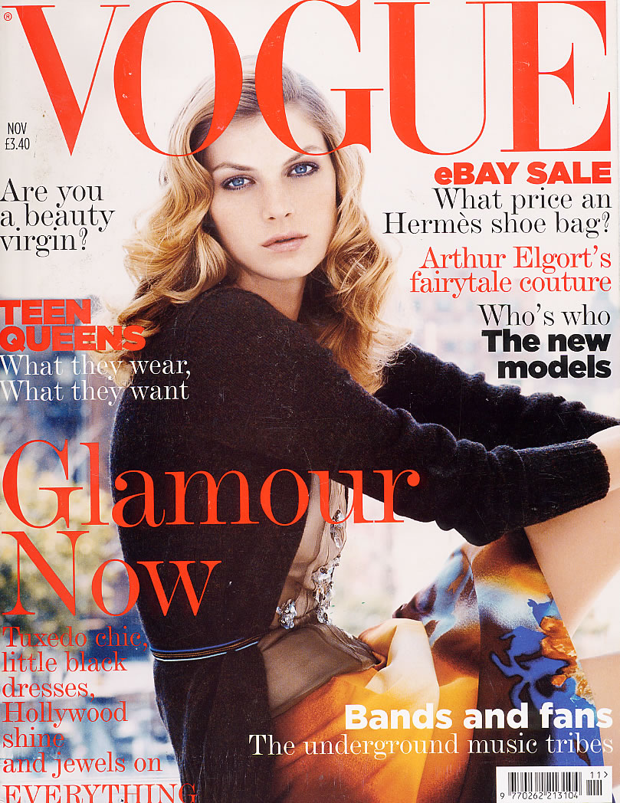
Vogue - Analysis
In pairs analyse the way that the front cover works on Vogue. Look at:
Image
Coverlines
Colours
Fonts
Layout
Use the Magazine Cover Analysis sheet on Weebly if you are struggling

Slide 10
Homework
Find a front cover of a magazine, or use one of the examples on Weebly (except for Vogue), and analyse.
Use the magazine cover analysis sheet to help you.
This work will go in your folder so as with your posters make it as detailed as possible

Slide 11
Pug/Ear
3
4
Puff
Masthead
1
7. How many colours are used for the text on the cover? Why?
Insert image
5
6
Main image
8 What techniques are used in the language and images to attract an audience?
coverline
2

Slide 12
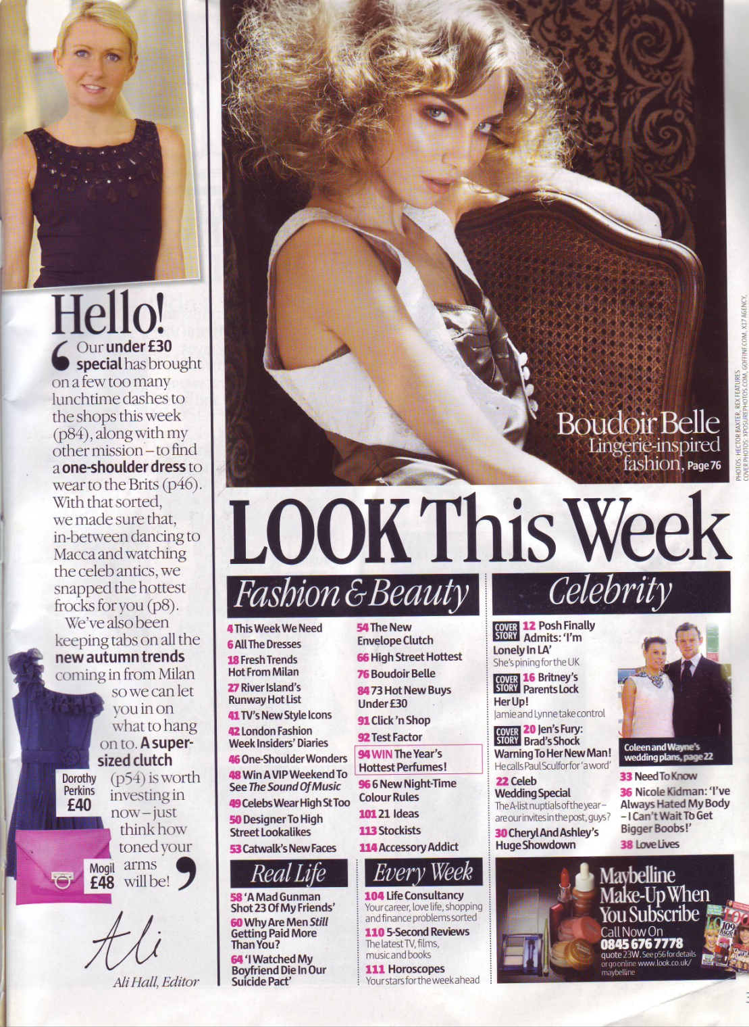
Analysing contents pages
Look at a contents page and try to answer these questions. The questions get gradually harder and will reflect your level of analysis. Remember that the examiner won't know your questions so answer in full sentences.
D grade - answer questions 1 -4
C/B grade - answer questions 1-6
A/A* grade answer questions 1-7
1. How many contents headings are there? List them
2. How many articles are referred to under each heading?
3. Work out the number of pages devoted to each main content heading.
4. Is there anything under the title of each article on the contents page? Why is that there?
5. Look at the cover of the magazine and which content items are highlighted. What do these aspects tell you about the messages that the magazine promotes? Does it suggest anything about the target audience in terms of:
- age
- gender
professional class
6. The contents page will often indicate which articles are the ‘regular’ items that appear in every issue and what are the ‘feature’ articles that only appear in this issue. Try to identify which are features and which are regulars
7. Pick out some of the language used in the contents page which is there to attract the audience – what techniques are used?

Slide 13
Editorial pages
What is an editor?
What is an editorial?
An editorial is a column written by an editor which introduces the magazine for this issue

Slide 14
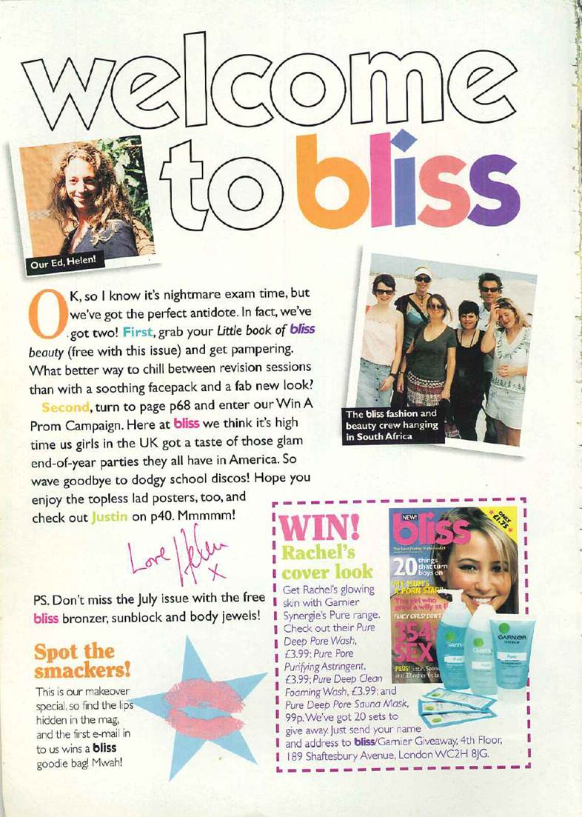
Look at these examples of editorials and come up with a list of what editorials do

Slide 15
Editorials
Tend to:
Be informal/ treat the reader like a friend
Include images
Read like a letter
Speak directly to the reader
Point the reader towards special features in the magazine
Include special offers/competitions

Slide 16
Analysis
Choose one contents page and one editorial of your own and analyse/annotate
There are documents on Weebly to guide you through your analysis if you need it
EXTENSION – analyse a second contents/editorial page

Slide 17
What is the log?
For this unit, you have to hand in a production log with your work. This is a kind of analytical diary of the work that you have completed
E grade | C grade | A grade
Some notes describing what you have done in the lesson | Notes explain clearly what you have done in the lesson with some reflection on how successful you have been and some analysis of what you have done | Detailed analysis of work achieved, with explanations of why/how work was created in this way

Slide 18
Example
Sample blog
Sample log
Your work will be in Word, but you should include screenshots of all the work that you have done, or scans/photos of it into your Word document
You will also include the actual documents at the end of your folder

Slide 19
The log
At the end of every lesson you must clearly state what work you have completed
This document is used as evidence of the work that you have done and when it is completed.
Time management is part of this assessment, so you must evidence your use of time
E | C | A
Time management may not be good | Time management is good | Time management is excellent

Slide 20
Monitoring
Your teachers will monitor your production logs to ensure you are progressing well and completing the work accurately
Your log will be saved on your google drive

Slide 21
Starting your log
November 27th
Analysing front covers in class
December 1st Homework – write up the homework that you have done

Slide 23
Analysing contents pages
Look at a contents page and try to answer these questions. The questions get gradually harder and will reflect your level of analysis. Remember that the examiner won't know your questions so answer in full sentences.
D grade - answer questions 1 -3
C/B grade - answer questions 1-5
A/A* grade answer questions 1-6
1. How many contents headings are there? List them
2. How many articles are referred to under each heading?
3. Is there anything under the title of each article on the contents page? Why is that there?
4. Look at the cover of the magazine and which content items are highlighted. What do these aspects tell you about the messages that the magazine promotes? Does it suggest anything about the target audience in terms of:
- age
- gender
professional class
5. The contents page will often indicate which articles are the ‘regular’ items that appear in every issue and what are the ‘feature’ articles that only appear in this issue. Try to identify which are features and which are regulars
6. Pick out some of the language used in the contents page which is there to attract the audience – what techniques are used?

Slide 24
Extension work
If you have finished, complete the analysis task again for another magazine contents page. There are examples on Weebly

Slide 25
Language use in contents pages
How is language used in this contents page

Slide 26
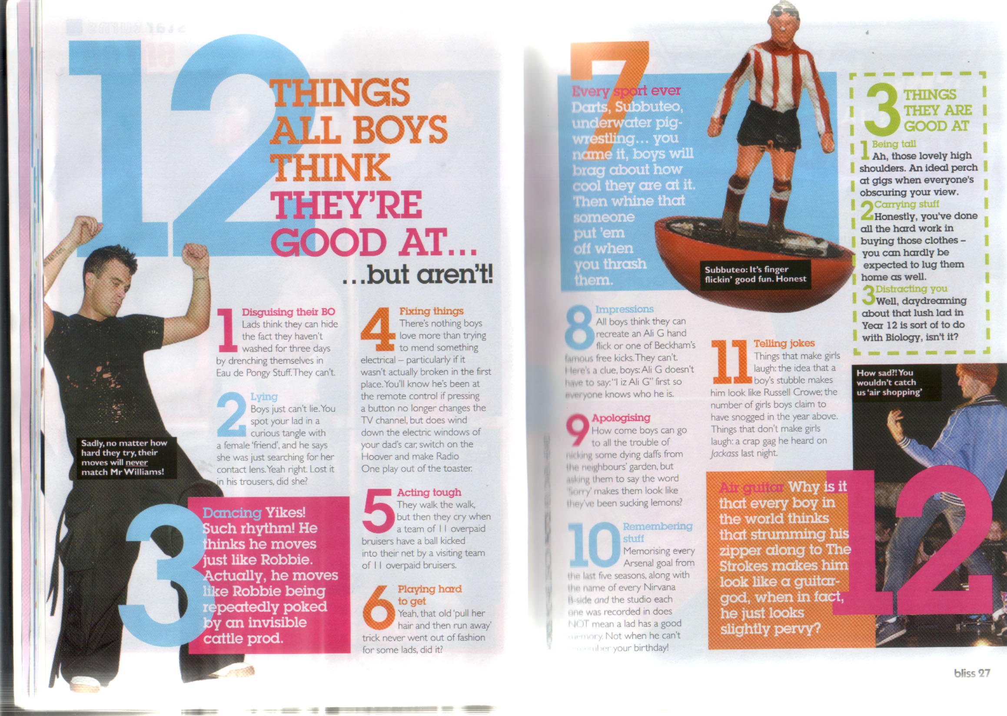
Analysing double page spreads

Slide 27
Double Page article analysis
REMEMBER to write the title before you start your work and write down the magazine and article that you are analysing.
Answer the following questions in detail. Remember that the moderator will not see these questions so make sure your answers make sense.
PRESENTATION
1. How are the headlines presented?
· Font
· Colour
· Position
· Size
2. How is the copy presented?
· Font
· Colour
· Position
· Percentage of page
3. How are the images presented?
· Colour
· Position
· Percentage of page
· Denotation and connotation of images
4. What do you notice about the overall layout of the article?
LANGUAGE 5. What type of language is used in the headlines?
· Give a quote and analyse
6. What type of language is used in the subheading?
· Give a quote and analyse
7. Choose 4 quotes from the main copy and analyse the use of language in each one separately. Choose examples of different types of language use. For example:
· Slang/colloquial language
· Imperatives "Go to the pool and …"
· Alliteration or sibilance "Fun, fantastic fashion for the fit female"
· Humour
· Rhetorical questions "Why are all men stupid?"
· Chatting directly to the reader "Anyway I'm sure you are desperate for me to get to the real point…"
8. Do you notice anything else about the language?

Slide 28
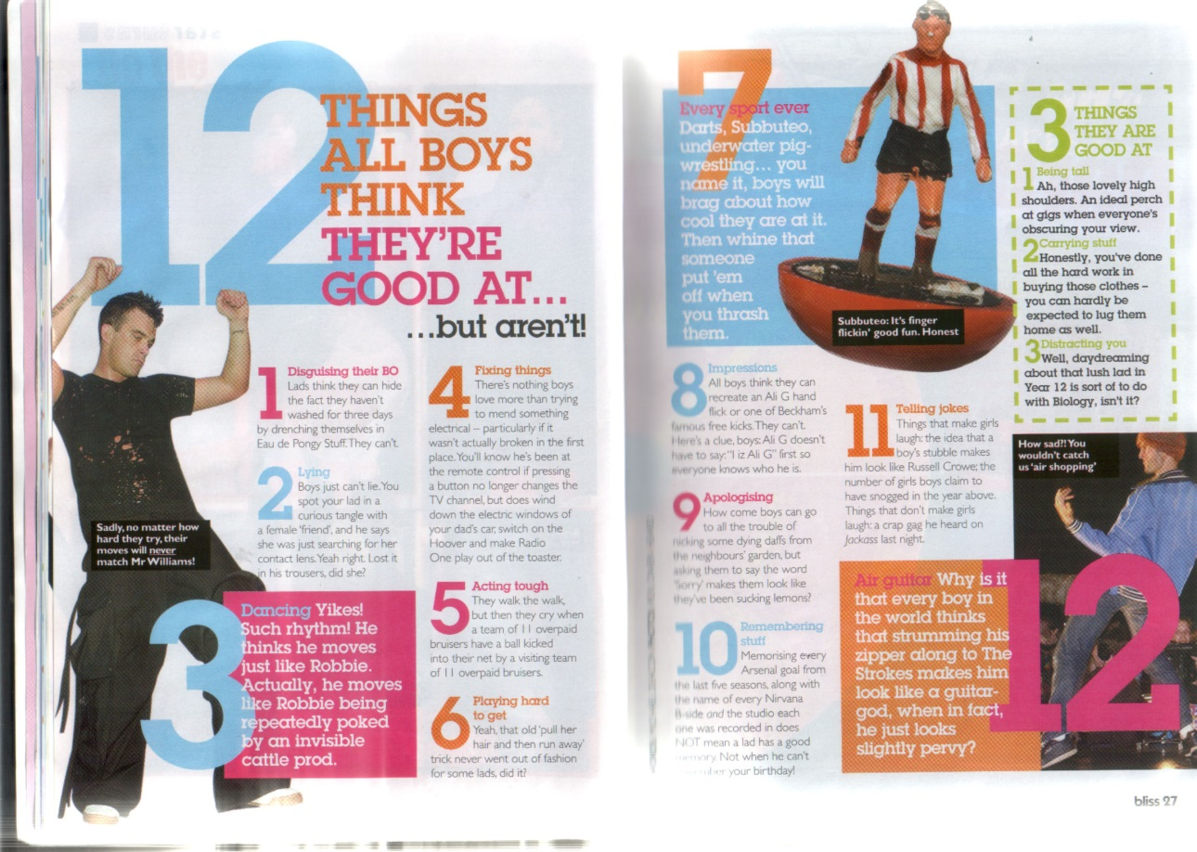
Layout
In chunks – each section separated by numbers
- makes it easy to access for the reader
In columns
- typical of magazines
Use of three images spread across the two pages
- Makes it appealing to the audience
Large headline
- makes the story clear to the audience

Slide 29
Headline
3 different colours
All in capital letters
12 is very large
Ellipsis
Exclamation mark

Slide 30
Images
Robbie – cool, all in black, dancing – the text in reverse block confirms the argument of the article
Subbuteo man = girls’ stereotypical idea of ‘pointless game’
Air guitar image – stereotypical reason to ridicule someone

Slide 31
Language
Direct address – makes it seem like the mag is talking directly to the reader
Slang – we use slang with our friends so it makes the mag seem like your friend

Slide 32
Grading
Grade | Exam Board mark scheme | What this means
U – G | Minimal research | Some labelling of real magazines
F – D | Basic Research | Basic annotations F – two comments E – 3 comments D – 4 comments with some analysis (connection to audience)
C – B | Proficient Research | Annotations including terminology and each point has analysis relating to the reader (at least 5 comments)
A – A | Excellent Research | Detailed and thorough analysis including terminology. Specific analysis of language included

Slide 33
Brainstorming
Brainstorm ideas for your magazine
Decide who your target audience is going to be and brainstorm what you might include in your magazine. Remember that you will have to take photographs YOURSELF to put in your magazine
E | C | A
A simple brainstorm with 5 or 6 ideas | A detailed brainstorm with 10+ideas with some explanation of the ideas | A detailed brainstorm with 10+ideas with clear explanation of the ideas, including some images
Now write up this work in your production log

Slide 34
Industry Research Task
B – A* Grades – see extension work on Weebly
D-B GRADES
Specific Audience
Your magazine must be made for a specific audience. It can’t be made for ‘everyone’.
You need to think about different audiences and what kind of content might be in the magazine.
There are always exceptions – boys sometimes read girls’ magazines, but the mag will still be targeted at teenage girls-
TASK: Your Magazine
Think about the genre of magazine that you might like to make and the target audience.
Research the range of titles currently published for your target audience. Produce a collage of front covers
Which of these magazines is the most popular?
Why do you think this?

Slide 35
Primary Audience Research
What does primary research mean?
Research that you have conducted yourself by directly contacting your audience
What does secondary research mean?
You read other people’s research (on the internet/ in books/ in newspapers etc) and use that to give you information about your audience

Slide 36
Primary Audience Research
Now it is time to do your own research – use the document on Weebly to choose the task that is most relevant to your level and target
Now write up your primary audience research in your log

Slide 37
Conduct the questionnaire
Conduct your questionnaire with at least 10 people from your target audience
Analyse the results (Excel/ paragraph to show understanding)
EXTENSION: Complete the Audience Research Task on Weebly

Slide 38
Plagiarism
Handing in coursework that is not your own is cheating
You will be disqualified if the moderator finds work in your folder that is not yours
You run the risk of being disqualified from ALL GCSEs in this session

Slide 39
Planning
Remember that this must be all your own work. You cannot take any of the article from real articles in magazines or on the internet and the images MUST be images you have taken yourself. However, you can imagine that your friend is a famous footballer and write an interview with them. You shouldn't interview them, but should make up the text of the interview yourself.
The examiner will not be impressed by silly comments that look like teenagers trying to impress their mates!

Slide 40
Planning – the article
Brainstorm what your double page spread article will be about – make sure that it is neat to go in your folder
Mock up your article
Write the text of the article in Word without layout decisions
See the document on Weebly – planning your double page spread article
Now write up your article planning in your log

Slide 41
Mock up

Slide 42
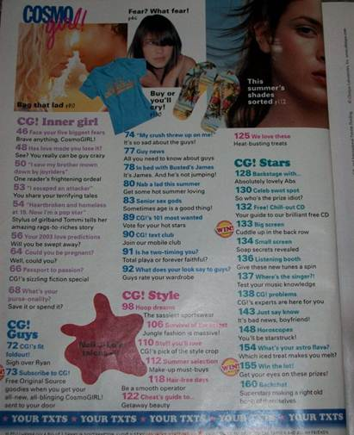
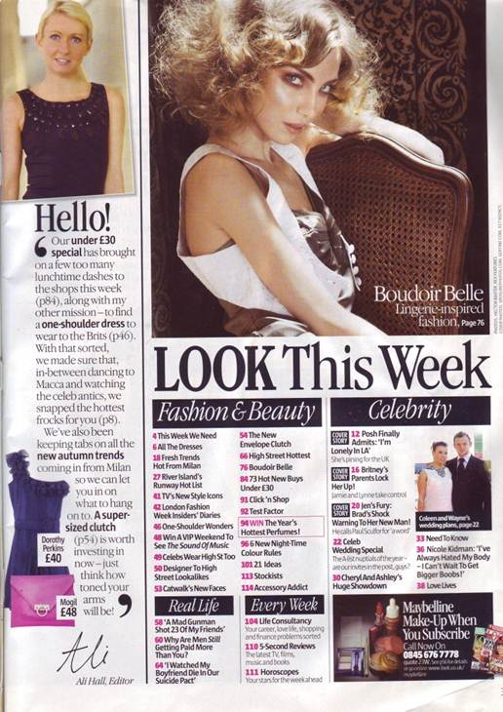
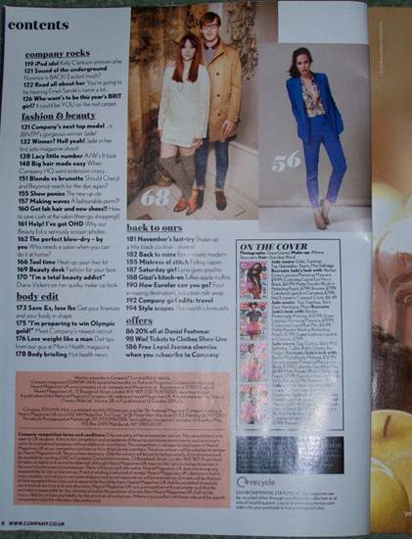
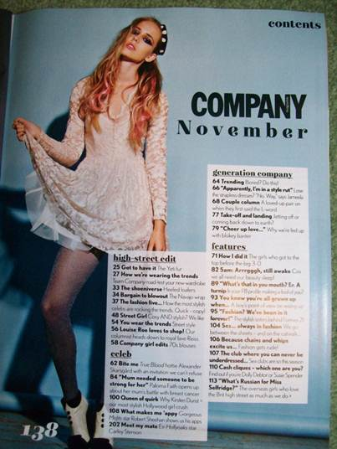

Slide 43
The contents page
Your contents page can be single or a double page spread
If you choose a double page spread it should include an editorial
Use your brainstorm sheet to think of ideas for articles in your contents page

Slide 44
Reminder: Language use
1
2
3
4
5
6
This sheet should be in your folder – use it to help you in the creation of your contents page

Slide 45
TASK
In Word, plan the text for the contents page for your magazine. Do not consider the font, colour or layout at this stage, just the text to be used in your magazine
E grade | C grade | A grade
10 article headlines | 20 article headlines some subheadings some creative use of language | 30+ article headlines subheadings for most Language used in a range of creative ways

Slide 46
Sample
Readers’ Stories
14 Nasty Knitter
My ‘friend’ sent messages knitted into scarves
26 Nifty Needles
I won the title of fastest knitter in Berkshire
48 Pull the wool over his eyes
How I kept knitting to hide my affair

Slide 47
Sample
Patterns for Winter
6 Scrumptious Scarves
Lightweight scarves for extra style
62 Do you do diamonds?
Classic diamond knit socks for that special Xmas present
etc

Slide 48
Subject sections
Readers’ Stories
14 Nasty Knitter
My ‘friend’ sent messages knitted into scarves
26 Nifty Needles
I won the title of fastest knitter in Berkshire
48 Pull the wool over his eyes
How I kept knitting to hide my affair
Patterns for Winter
6 Scrumptious Scarves
Lightweight scarves for extra style
62 Do you do diamonds?
Classic diamond knit socks for that special Xmas present
etc
Numbers in order but not consecutive
Language use
Alliteration
Rhyme
Pun
Rhetorical question
triplets

Slide 49
Extension
If you have finished, first check that you have been as creative as possible with your language use
Then consider the layout of your contents page. Think about use of images, colour, blocking, titling, position of your editorial etc.
For a B-A* grade, you should aim to create a double page spread for your contents page
Draw the mock up of your page/s on A4 paper

Slide 50
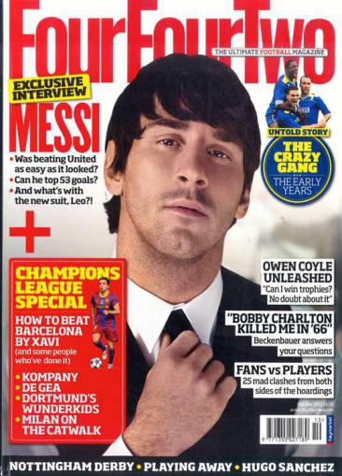
Planning your front cover
Points to remember
Should have a big image which takes up most of the page
Needs a masthead
Needs at least 5 coverlines
Needs barcode, date, price, puff

Slide 51
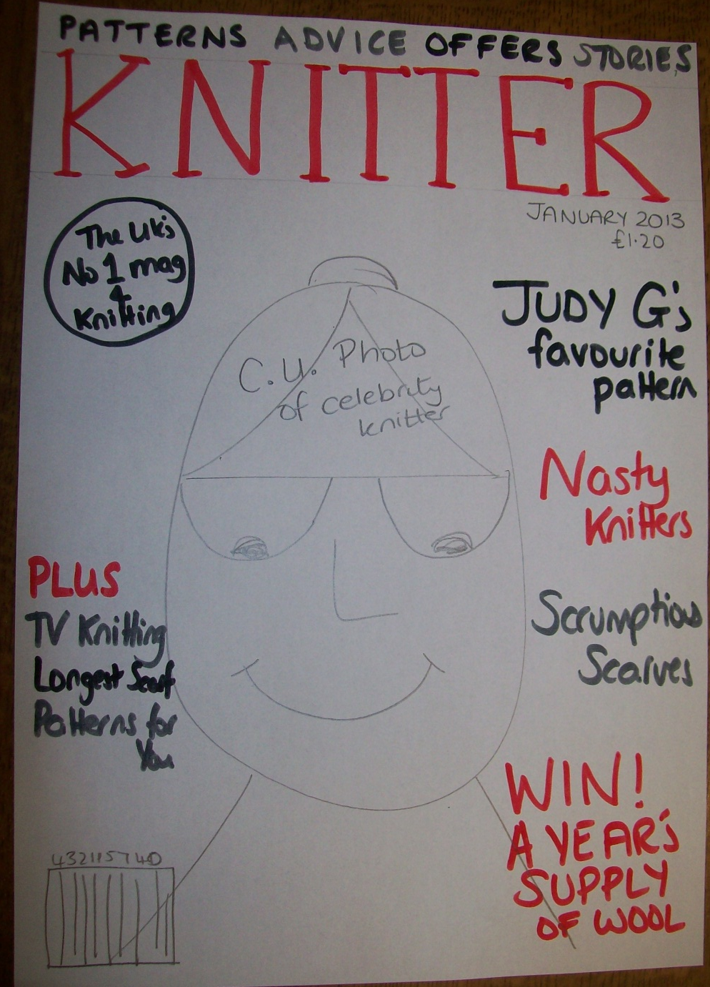
Mock up
Draw a detailed mock up of your cover with
all of the coverlines
a description of your image
decisions about colours

Slide 52
Planning your images
Remember that you need to keep all of the unmanipulated images that you have taken for your work
Remember that the images cannot appear anywhere else on the internet (don’t post the images you take for your work onto Facebook!)

Slide 53
Planning your masthead
Consider the layout of your masthead. Choose a real magazine to base your masthead on so that it looks professional.
Show the real masthead/s and your decision
Consider the colour/ font/ layout
Write bullet points or a short paragraph to explain your reasons

Slide 54
Include a title Masthead Designs
Include annotations as to why you have chosen/ not chosen some of your designs
Decide the name of your magazine
Choose a real magazine to base your masthead on
Try out different fonts and colours
Use dafont or other font websites
Avoid Word Art fonts with a gradient colour
Your masthead should be a banner across the whole of your front cover
Access this planning sheet on Weebly

Slide 55
Masthead design - marks
A | B | C | D or below
Planning of masthead design clearly shown, analytical annotations as to why particular designs were rejected and why one was chosen. Font, colour and layout decided | Planning of masthead clearly shown, annotations as to why particular designs were rejected and why one was chosen. Font, colour and layout decided | Planning of masthead shown, some annotation as to why particular designs were rejected and why one was chosen. Font, colour and layout decided | Included

Slide 56
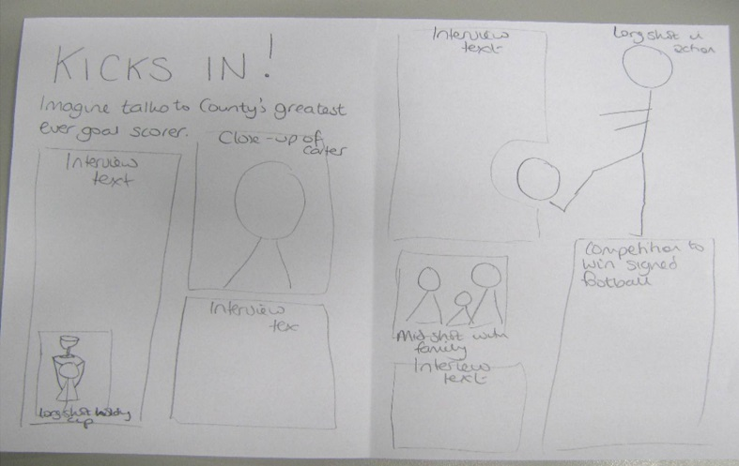
Making your article
Use your mock up to make your real article on Publisher.
Copy and paste the Word planning of your article into the text boxes on Publisher
Points to remember
Try to include lots of images
Make sure all text is in columns – use the link text box tool to allow you to adjust column sizes
Font size of body copy should not be more than 12
Use the Construction – Mark your Own sheet on Weebly for grading

Slide 57
Check
All unmanipulated, original photos printed on A4 in colour to go in your folder. Fit at least 6 photos per page (Title: Unmanipulated Images)

Slide 58
Task
Create your contents page in Publisher
Use your mock up for the layout
Copy and paste the contents that you have written in Word into the separate text boxes
Remember
Lots of images
Max 12 for font size for copy
Use the
Construction – Mark your Own sheet
on Weebly for grading

Slide 59
Task
Make your front cover in Publisher
Use your mock up and your masthead design to help
Make sure your main image is large and well framed
What does ‘well framed’ mean?
The model is positioned in a sensible position within the whole of the photograph

Slide 60
Images
Front cover image should be large
Shouldn’t be enlarged unless on high pixel ratio camera because makes them pixelated
Lighting should be bright on the subject (not behind them).
If your camera has the function –set the white balance – see instruction booklet!
Front cover image – leave enough space above the model to place the masthead
Outside images shouldn’t be at night
Take a portrait image for your cover (not landscape)

Slide 61
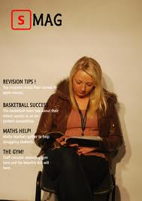
Conventions
Why is this cover less successful?

Slide 62
Conventions
Put images into Photoshop and play with the colour/ contrast effects to improve your photos
Get eye contact with your audience
Large masthead
Large coverlines
3 colours for coverlines
No white empty space
Small font for main text

Slide 63
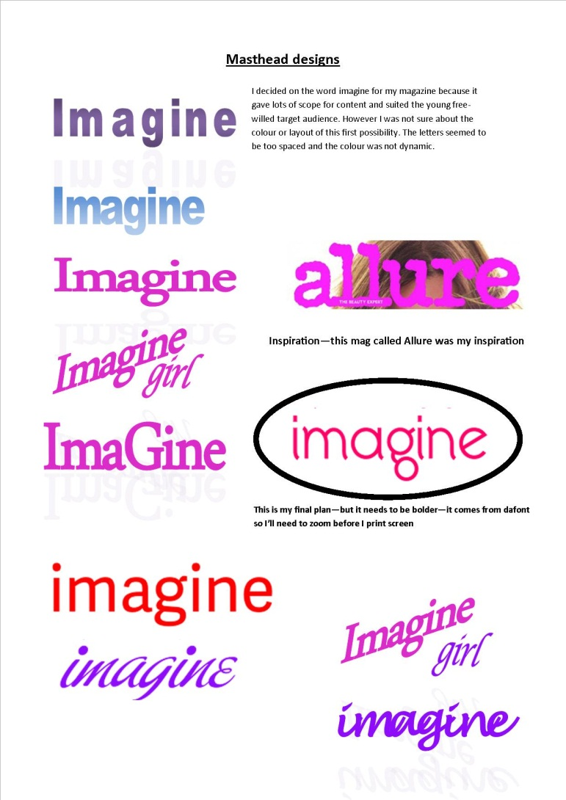

Slide 64
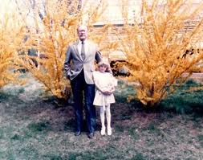
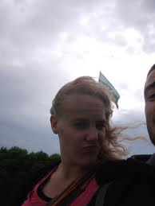
Framing
DON’T DO THIS!

Slide 65
Things to remember
Large masthead
Large image in sharp focus
Background is blurred or plain and usually light colour
Limited colour scheme – 4 colours max, but usually only 3
Some font variety in coverlines
Coverlines do not go over the face
Coverlines on both sides of the page

Slide 66
Use mark your own sheets on Weebly (under mark schemes)
 | A-A* | B | C | D or below
Use of IT | Excellent use of IT so that the magazine looks like a professional magazine. Careful attention to detail. Images are cropped, resized and manipulated as appropriate. | Excellent use of IT so that the magazine looks almost like a professional magazine. Attention to detail. Most images are cropped, resized and manipulated as appropriate. | Very good use of IT. A lot of images are cropped, resized and manipulated as appropriate. | Average use of IT. Very little manipulation of images.
Font | A variety of font sizes and types are used. The font size for the articles is quite small and is generally size 12. | A variety of font sizes and types used. The font size for the articles is quite small and is generally size 12. | Some variety of font size and type. Font size for double page spread article or other articles may be too big (over size 12). | The font size use in the text is too big and looks unprofessional. Font size may be too big in order to disguise the fact that the pupil has not written a lot (this does not work!). The font is more or less the same throughout– may have used times new roman throughout.
Spelling | No spelling or grammatical errors. The language takes into account the target audience | No spelling or grammatical errors. The language takes into account the target audience. | Contains a few spelling or grammatical errors. May contain poor punctuation. | Contains a lot of spelling or grammatical errors. May contain word omissions or poor punctuation.
Photographs | Images are cropped appropriately. Images are sharp and clear in focus. In particular the image on the front cover is in focus. All images are pupils’ own. | Images are cropped appropriately. The majority of images are sharp and clear in focus. In particular the image on the front cover is good. The majority of images are pupils’ own. | Some Images are cropped appropriately. Most images are sharp and clear in focus. Some images are not the pupils own and have been taken from a website. | Some images are in focus. Some images are not the pupils own and have been taken from a website.
Photographs | A variety of shot distances are used (ex-close up, close-up, mid shot, long shot.) Images and text are integrated professionally. | A variety of shot distances are used. Images and text are integrated well. | Some variety of shot distances are used. Images will be placed on the page with some integration with text. | Images are just placed on the page with no real thought or effort.
Mise-en-scene | Has selected appropriate mise-en-scene including colour, lighting, objects and setting. Careful attention to detail. | Has selected appropriate mise-en-scene including colour, lighting, objects and setting | Has selected some appropriate mise-en-scene including colour, lighting, objects and setting | Mise-en-scene has been considered to a basic standard
4/5 Pages Cover Contents/ Editorial Double Pg Spread (2pages) | All 5 pages are produced to an excellent / professional standard. | All 4/5 pages are produced to a very high standard. | All 4 pages are produced to a good standard. May lack professional finish (ex-it may contain empty white spaces, may not have page numbers, may have used images copied from the internet) | All 4 pages are produced to a basic standard. Work is rushed, unfinished and contains a lot of empty white spaces. EVERY PAGE MUST BE INCLUDED OR THE WORK WILL NOT MEET THE REQUIRMENT OF THE BRIEF.

Slide 67
Writing your evaluation
Before you start your evaluation, you need to gather some audience feedback. Ask other people (from your target audience) to look at your work and give you some comments –both positive and negative.
You need to write an evaluation for your portfolio. The evaluation should be between 500 – 800 words long and it should be word-processed. Your brief and the title of your production should be stated clearly as the heading of your evaluation
As you write, aim to analyse and evaluate throughout. Do not repeat anything (eg if a bullet points are similar and you have already answered the point, don’t write it again) and always say WHY you did something, not just that you did it. DON’T MOAN! The examiner will not respect your work if it just moans about the software etc!

Slide 68
3 sections
RESEARCH AND PLANNING
Explain what research you did and what you learned (real magazines and audience research)
Explain what planning you did and why it was helpful
CONSTRUCTION
Explain how you made your pages and WHY you made them in that way
EVALUATION
Explain what audience feedback you got
Say if you agree or disagree with their opinions and explain why
Analyse your final pages, explaining the connotations created. (eg why you used certain colours, fonts, images, words etc)

Slide 69
Mark Scheme – on Weebly
Level 4 (24–30 marks)
• There is a detailed evaluation of the monitoring of decisions and revisions.
• There is a detailed discussion of how the brief related to research into similar media texts and target audiences.
• There is excellent understanding of the forms and conventions used in the production.
• There is excellent understanding of the significance of audience feedback.
• There is excellent ability to communicate.
• There is a thorough evaluation of the success of the finished media text in meeting the original brief.
• There is an accurate command of appropriate medium-specific terminology.
A* | 27
A | 24
B | 22
C | 18
D | 15
E | 12
F | 9
G | 6
U | 0

Slide 70
Ticklist
Use the ticklist on Weebly to ensure that everything is in your folder in the right order

