Slide 1
GCSE Magazines
Making the double page spread

Slide 2
The bigger picture
You have to complete:
A front cover for a new magazine
A contents/editorial page
A double page spread article
You should have completed
All of your research into real magazines/ target audience
All of your planning

Slide 3
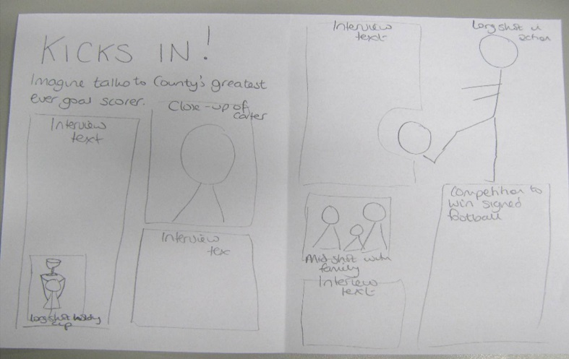
Making your article
Use your mock up to make your real article on Publisher.
Copy and paste the Word planning of your article into the text boxes on Publisher
Points to remember
Try to include lots of images
Make sure all text is in columns Font size of body copy should not be more than 12
Use the Construction – Mark your Own sheet on Moodle for grading

Slide 4
Check
All unmanipulated, original photos printed on A4 in colour to go in your folder. Fit at least 6 photos per page (Title: Unmanipulated Images)

Slide 5
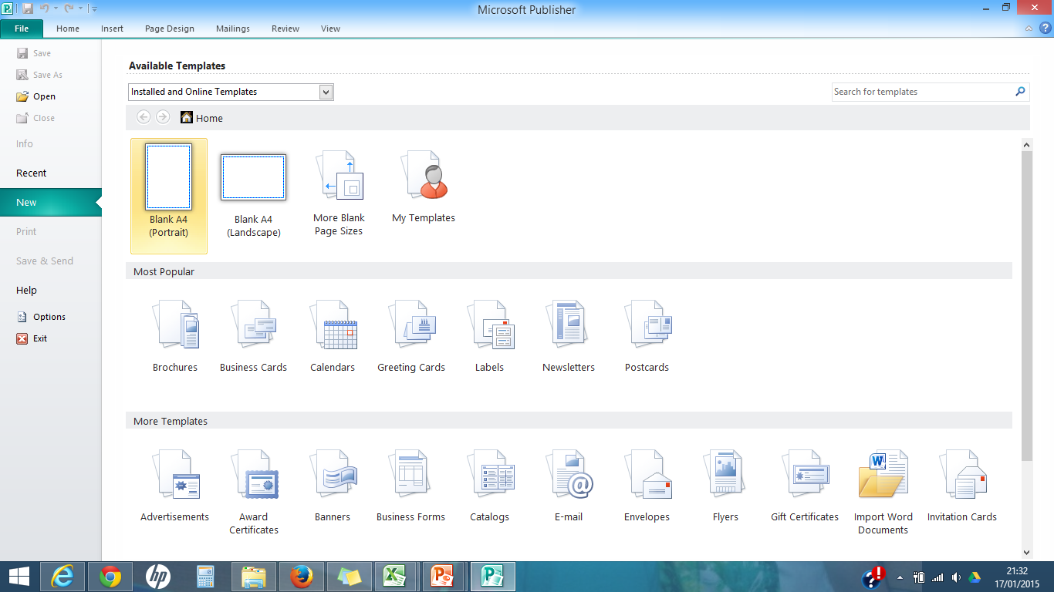
Open Publisher and choose Blank A4

Slide 6
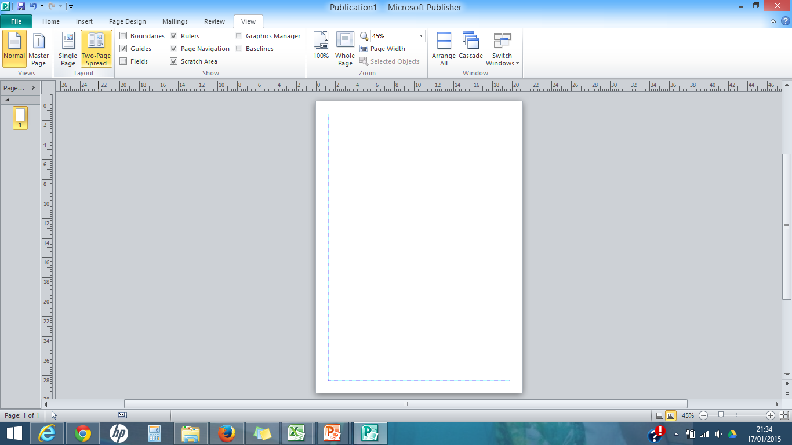
On the view tab, choose Two-page spread

Slide 7
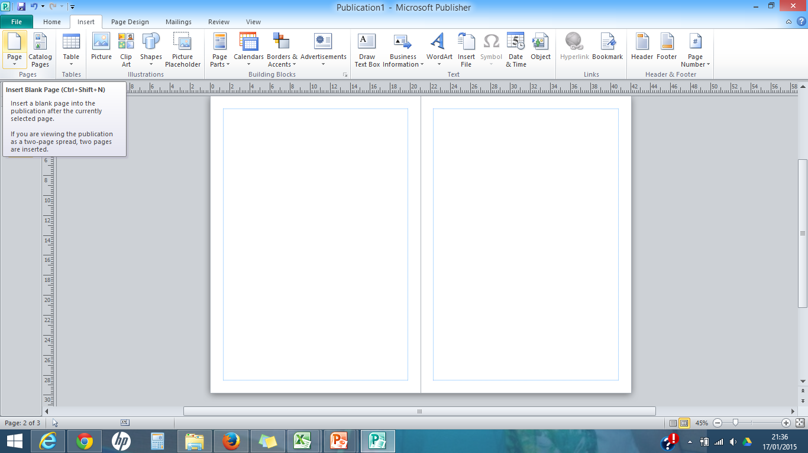
On the INSERT tab, choose Page

Slide 8
Choose Draw Text Box, then draw a box to create your columns

Slide 9
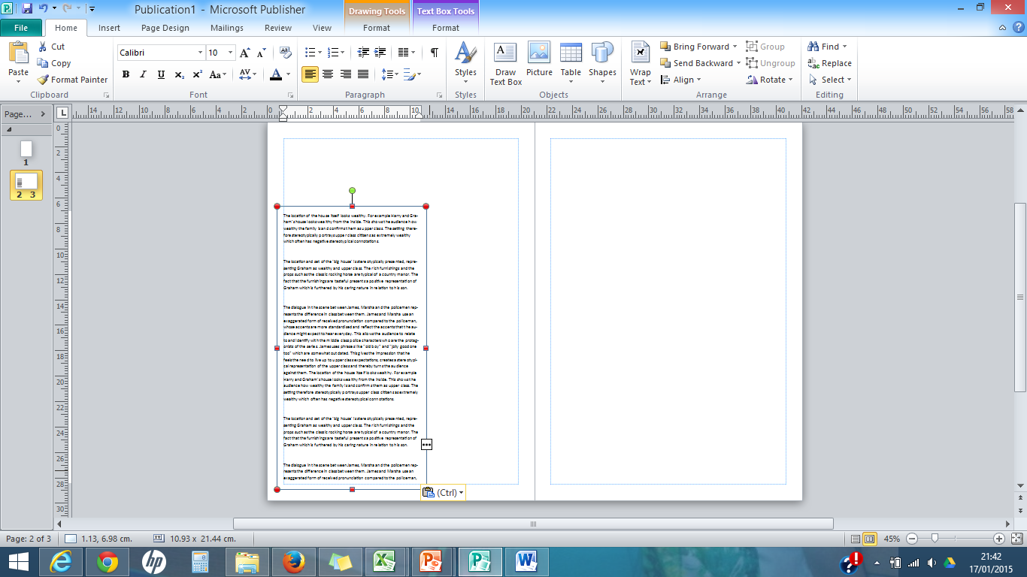
Copy and paste your article text from Word, into the text box

Slide 10
Draw another text box where necessary. Remember that you can use half the space between the blue line and the edge of the page

Slide 11
Sometimes the text will overflow from one text box into another. To make this happen automatically, click on the first text box then click on the link button.
If you move your mouse into the second text box, a jug will appear.
You can then ‘pour’ the excess text from the first text box into the second.

Slide 12
If you decide to reduce the size of the first text box, the extra text will flow into the second so that you don’t lose any of your story.

Slide 13
For your title, choose Word Art and a style without a shadow

Slide 14
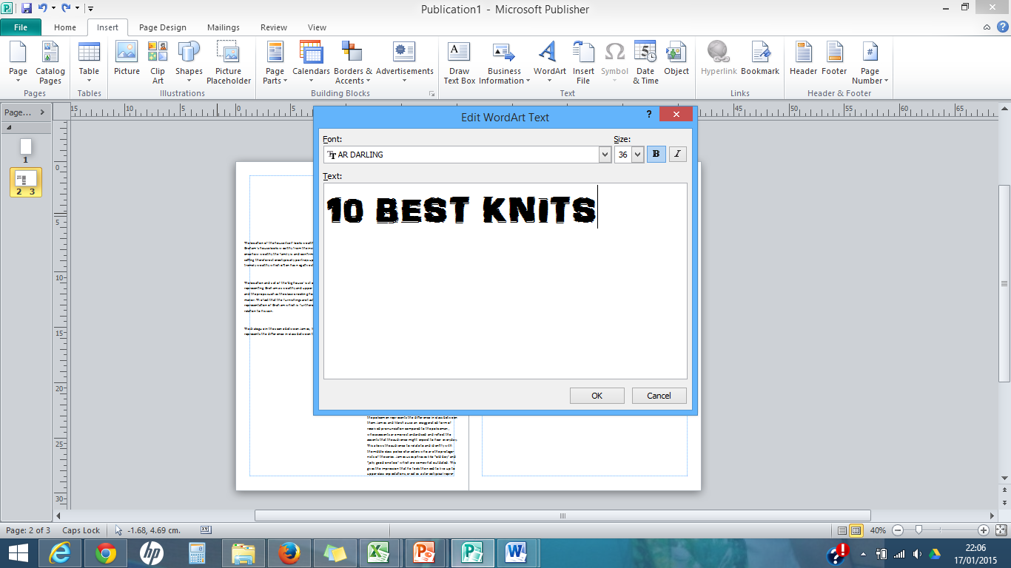
Choose your font (try installing a font from Dafont.com) and type in your text

Slide 15
Choose the Shape Fill/Shape Outline options to recolour your title.
Remember that this is the title of the article– not the title of the magazine

Slide 16
For different colours and sizes, create a new Word Art for each section of your title

Slide 17
For a professional finish,
your text should be ‘justified’. This means that the text reaches both the left and right side of the text box.
Highlight the text and choose the ‘justify’ button above Paragraph

Slide 18
Insert your images, trying to keep to the lines of the columns

Slide 19
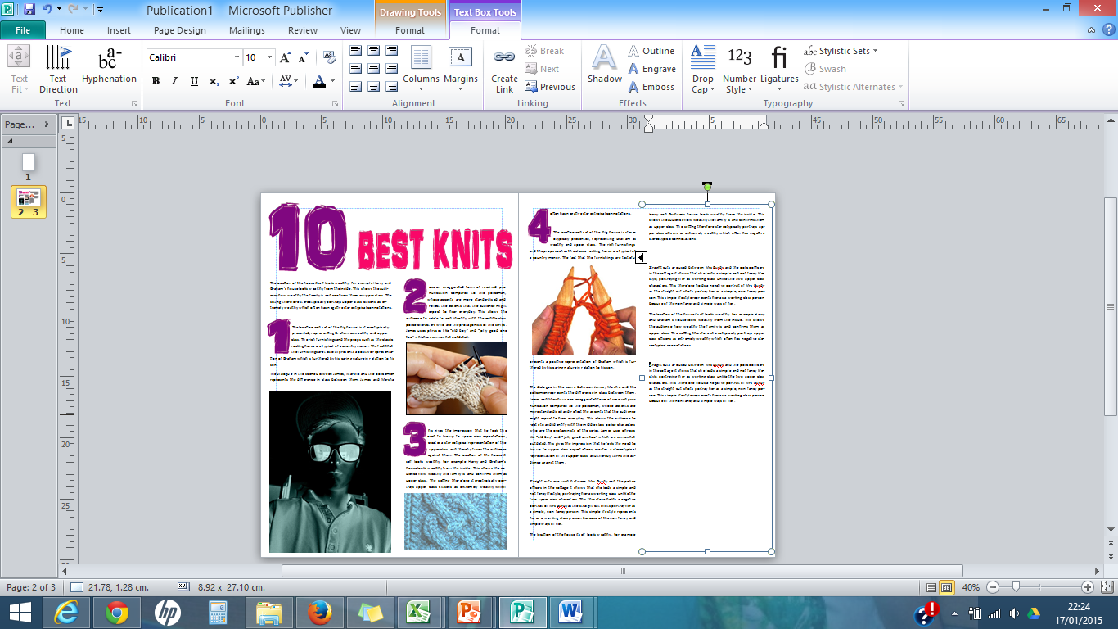
Continue to fill your article with images and text

Slide 20
Check list
Remember page numbers – the left page is an even number, the right page is odd
Most magazines have the magazine name and date on each page – look for examples in the ones that you analysed in your folder
Remember the maximum font size should be 12
Make sure the font for the main text is simple and easy to read
Try to avoid white, empty space in your article
Proof read carefully – it must be accurate

Slide 21
Grading
 | A/A* Excellent | B Very good | C Good | D Basic
ICT
Font
Language
Photos
Mise en Scene
Overall standard
See Mark your own sheet on Moodle to show a break down of how to reach the grade you are working towards

Slide 22
Production Log
Write up your production log to cover all of the work that you have done today
Remember to be reflective about the work that you have done – don’t just describe

