Slide 1
Writing the essay
Weebly version

Slide 2
Grading
KEY WORDS
CODES AND CONVENTIONS
MESSAGES AND VALUES
REPRESENTATION
A/A* To write analytically and accurately showing personal insight
B/C To analyse the way in which the characters have been created and the meanings received by the audience
D To describe the characters and show why they are created in that way

Slide 3
Plagiarism
Plagiarism is when work is copied from somewhere else
You can be disqualified from this GCSE and in some cases from all of the GCSEs entered in this session
DON’T DO IT!

Slide 4
STYLE
Use terminology
camera angles: close up, tilt, pan, establishing shot, etc
sound terminology: diegetic, voiceover etc
Write formally – like a text book
Analyse! (Use PEAQ formula for each point)
POINT
EXAMPLE
ANALYSIS
REFER TO THE QUESTION

Slide 5
Starting your essay
This information needs to go at the top of your essay. Your name/candidate number and centre number should be at the top of every page
Name
Candidate number
Centre: George Spencer Academy
Centre Number 28278
Unit B321: Analytical Assignment
Title: Compare two teen movies in terms of representations, conventions, messages and values

Slide 6
Section 1:
Conventions of Teen movies
ESSAY PLAN
State briefly without examples what the conventions of teen movies are
State briefly what The Breakfast Club (John Hughes, 1985) is about. (max 5 sentences)
Which conventions does it include? Give examples for each convention
State briefly what Mean Girls (Waters, 2004) is about.
Which conventions does it include? Give examples for each convention

Slide 7
OR

Slide 8
Section 1:
Conventions of Teen movies
ESSAY PLAN
State briefly without examples what the conventions of teen movies are
State briefly what The Breakfast Club (John Hughes, 1985) is about. (max 5 sentences)
Which conventions does it include? Give examples for each convention
State briefly what The Duff (Sandel, 2015) is about.
Which conventions does it include? Give examples for each convention

Slide 9
Section 2: The Breakfast Club messages, values and representations
ESSAY PLAN
Use 2 analysis sheets for this section
The montage of shots around the school during Brian’s voice over.
The introduction of the characters

Slide 10
Section 3: Mean Girls messages, values and representations
ESSAY PLAN
This section is answered using the Mean Girls analysis sheet that you found on Moodle
Write one paragraph for each box on the analysis sheet

Slide 11
OR

Slide 12
Section 3: The Duff messages, values and representations
ESSAY PLAN
This section is answered using the The Duff
analysis sheet that you found on Weebly
Write one paragraph for each box on the
analysis sheet

Slide 13
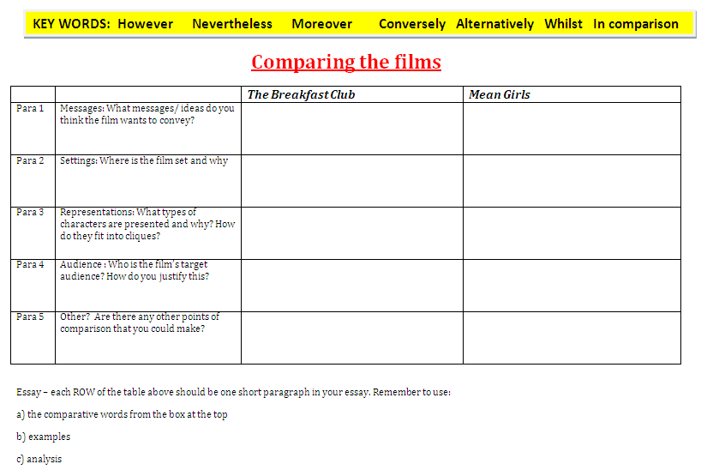
Conclusion
ESSAY PLAN
This section compares the movies. Use the sheet that you filled in comparing the movies.
Each row of your table should be one short paragraph in your essay. Remember to use the comparing words in the highlighted box at the top of the table.

Slide 14
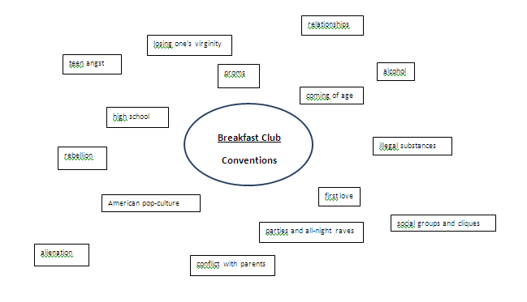
Conventions of The Breakfast Club
On your h drive you have a spider diagram with the conventions of teen movies. You have written examples on the sheet.
In your essay write about some of the conventions and give examples of how they are used in the film.
HINTS FOR A TOP GRADE
Back to paragraph plan

Slide 15
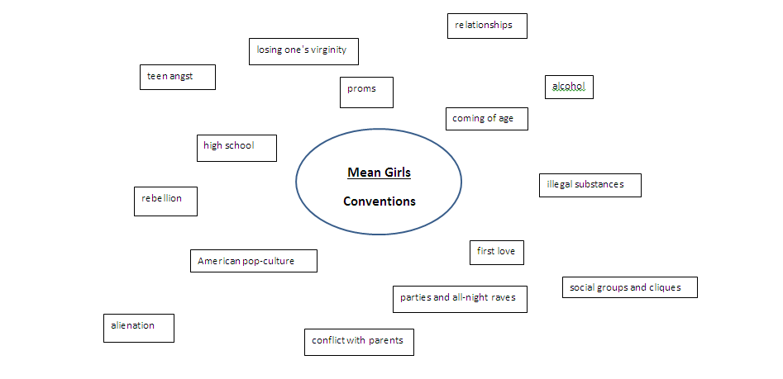
Use this sheet – on Weebly under TBC, Mean Girls or The Duff
Write examples for 3-5 conventions that are used in the film
Back to essay plan

Slide 16
Grading for conventions paragraphs
A/A* Detailed examples of conventions seen in the movies with explanations of how the conventions affect the movie
B/C Examples given of how the conventions are used within the films, with some explanations of effect
D/E list of conventions seen in the movies with some limited examples.
Note – explanations should be specific – use character names etc

Slide 17
Montage
During the montage the shots suggest two different ideas. Try splitting the shots into neutral representations of school and negative representations.
What is the director suggesting by the neutral representations? (eg the empty hall and corridor, the canteen, etc)
What is suggested by the other shots? (the grafitti, the litter, the exercise book etc)
What themes are introduced during this section, and how are they conveyed?

Slide 18
Themes that are explored in the film
Cliques and barriers between students
Rebellion
Conflict with parents and finding your own way in life

Slide 19
Representations
Before we meet the characters what is suggested about them from the images connected to Brian’s voice over?
What is suggested by the way that each character is introduced outside the school?
Claire
Brian
Andrew
John
Allison
How is this introduction confirmed by the way that they sit down?
Use your notes from this sheet
Back to essay plan

Slide 20
If you have finished…
Check your work carefully –
Have you remembered capital letters for names and for the titles of the films?
Read your work slowly – do the sentences make sense?
Do the sentences sound like a proper essay? (avoid words like get, got, thing, nice, bit)
Make sure there is no slang – use formal English (avoid dad, mum, mate, stuff etc)

Slide 21
HINTS FOR A TOP GRADE
Make sure your examples are detailed and clear
Try to say WHY these conventions were used in the film
Check your work carefully
Write formally
Back

Slide 22
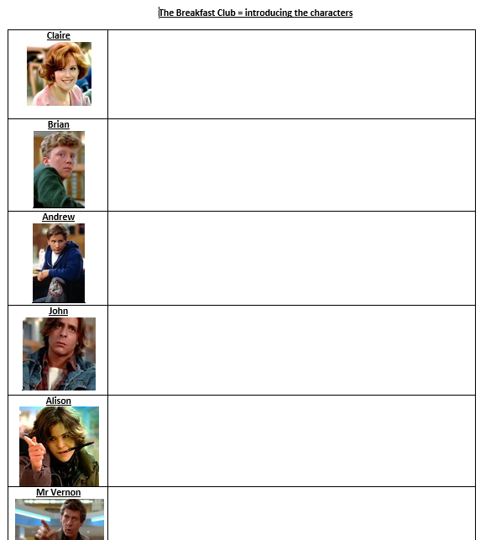

Slide 23
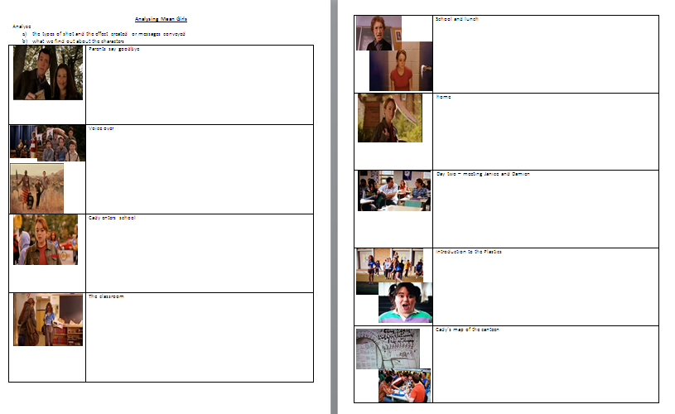
Mean Girls analysis of opening sequence

Slide 24
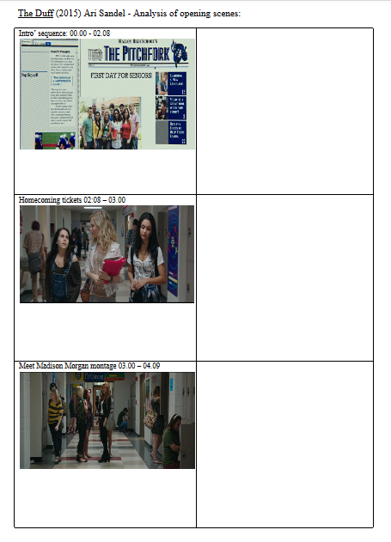
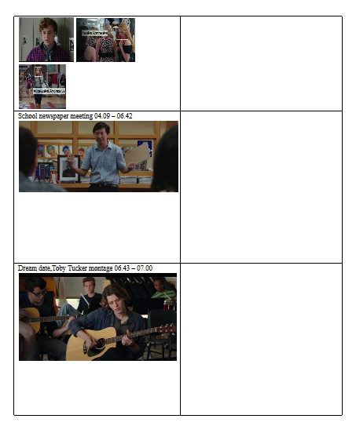
The Duff analysis of opening sequence

